Slide 1
Oscillators

Slide 2
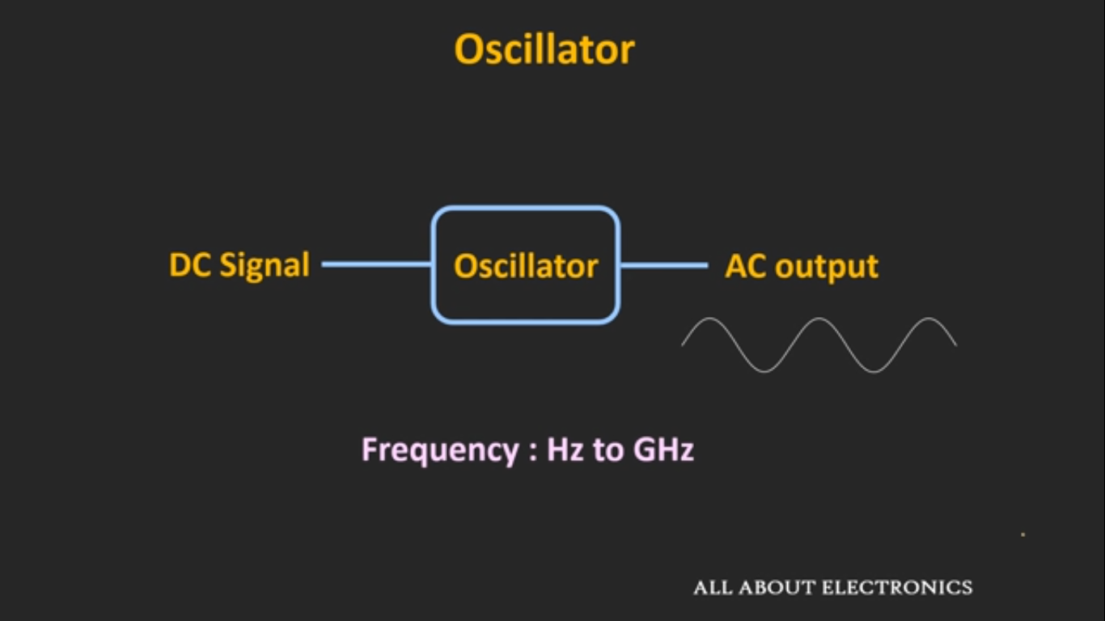
Oscillators

Slide 3
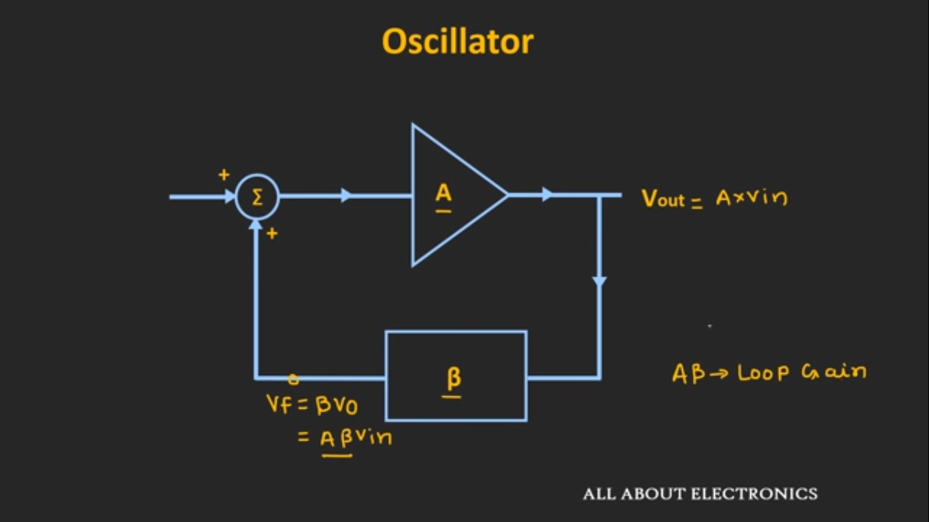
Working Principle

Slide 4
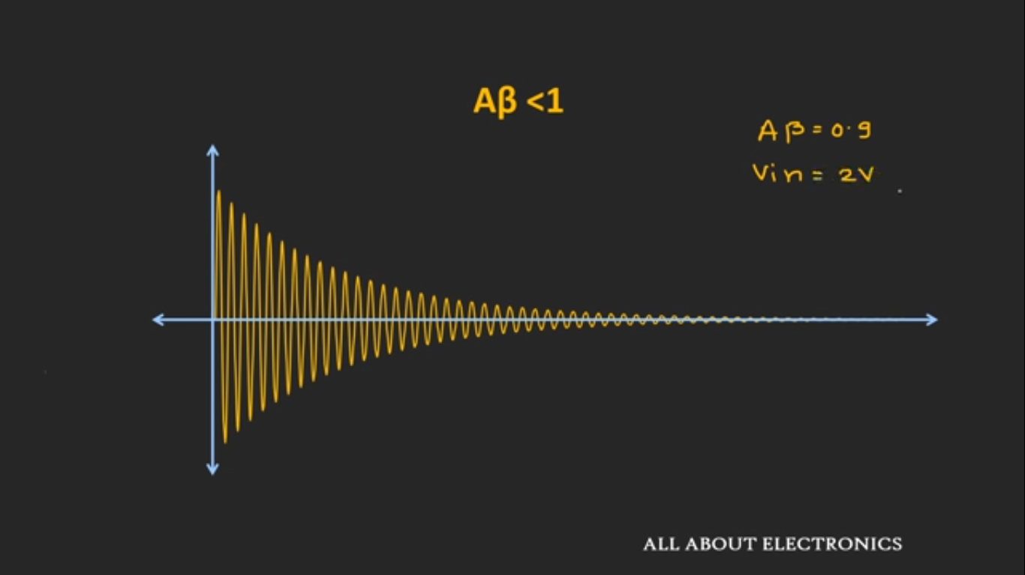
Working Principle

Slide 5
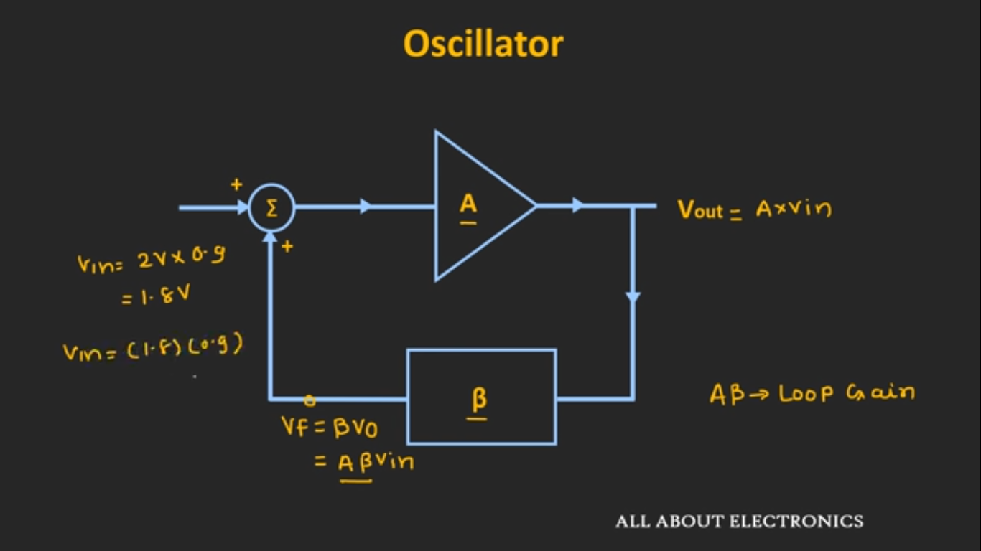
Working Principle

Slide 6
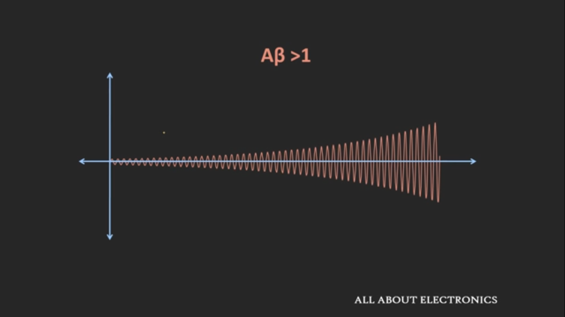
Working Principle

Slide 7
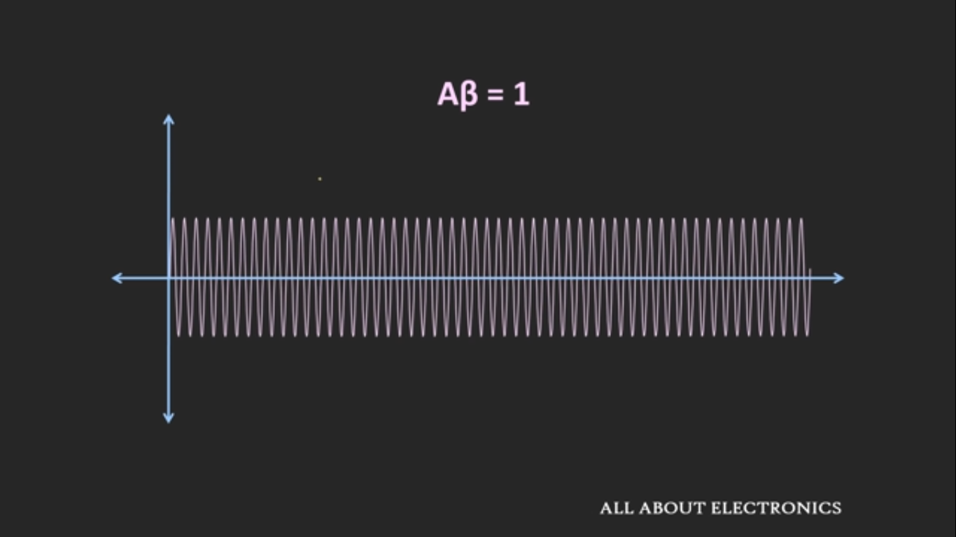
Working Principle

Slide 8
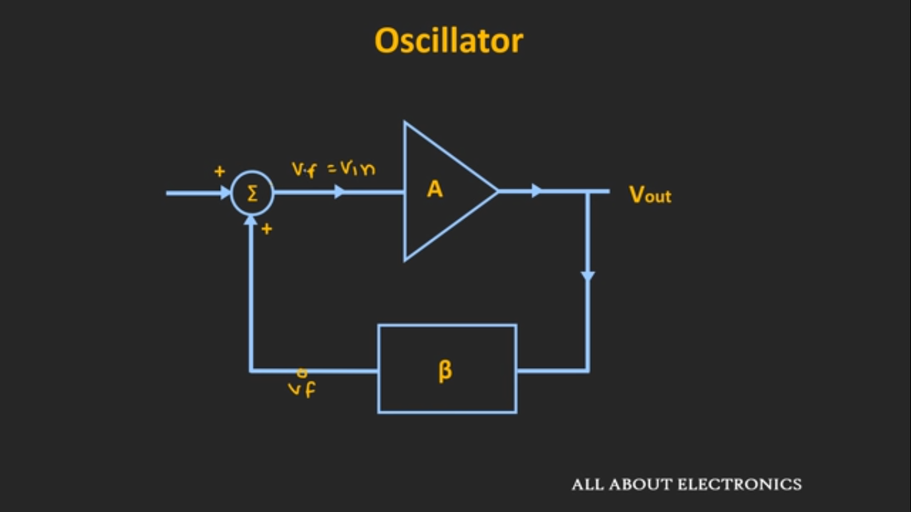
Working Principle

Slide 9
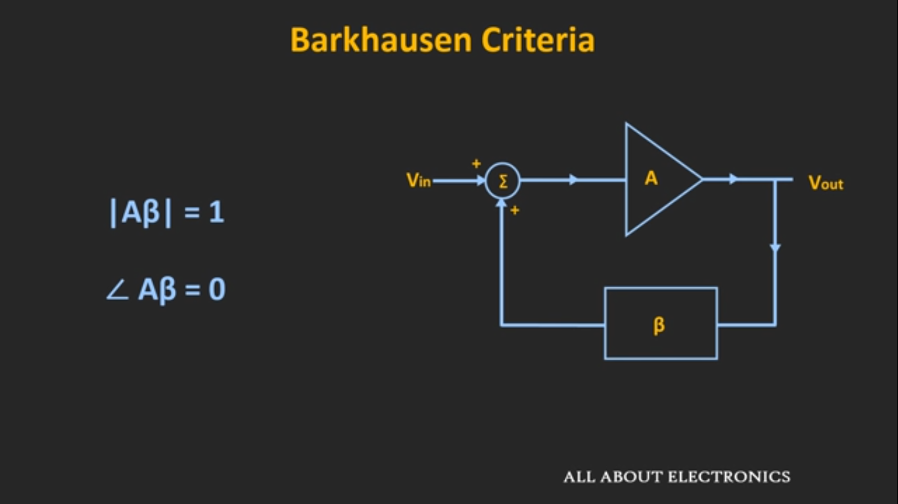

Working Principle

Slide 10
Types of Oscillators
RC Phase Shift Oscillator (RC)
Sinusoidal Oscillators
Wein Bridge Oscillator (RC)
Colpitts Oscillator (LC)
Non-Sinusoidal Oscillators
Relaxation Timer

Slide 11
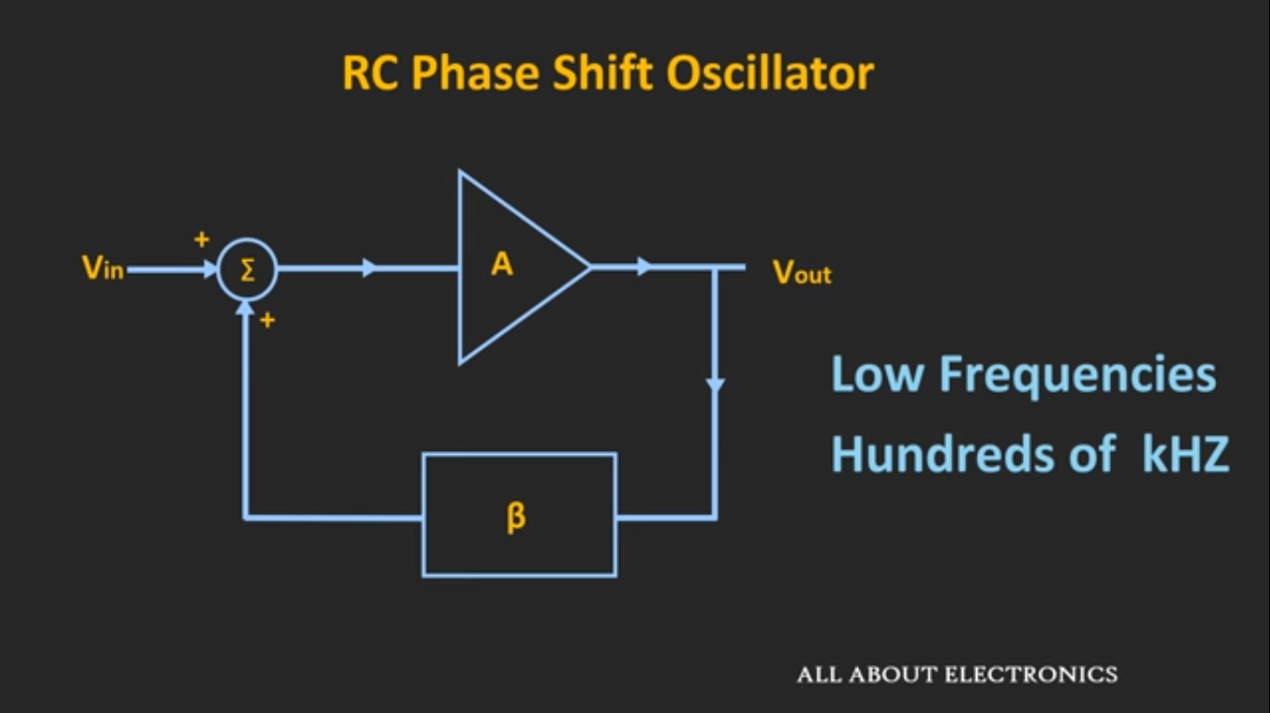
RC Phase Shift Oscillators

Slide 12
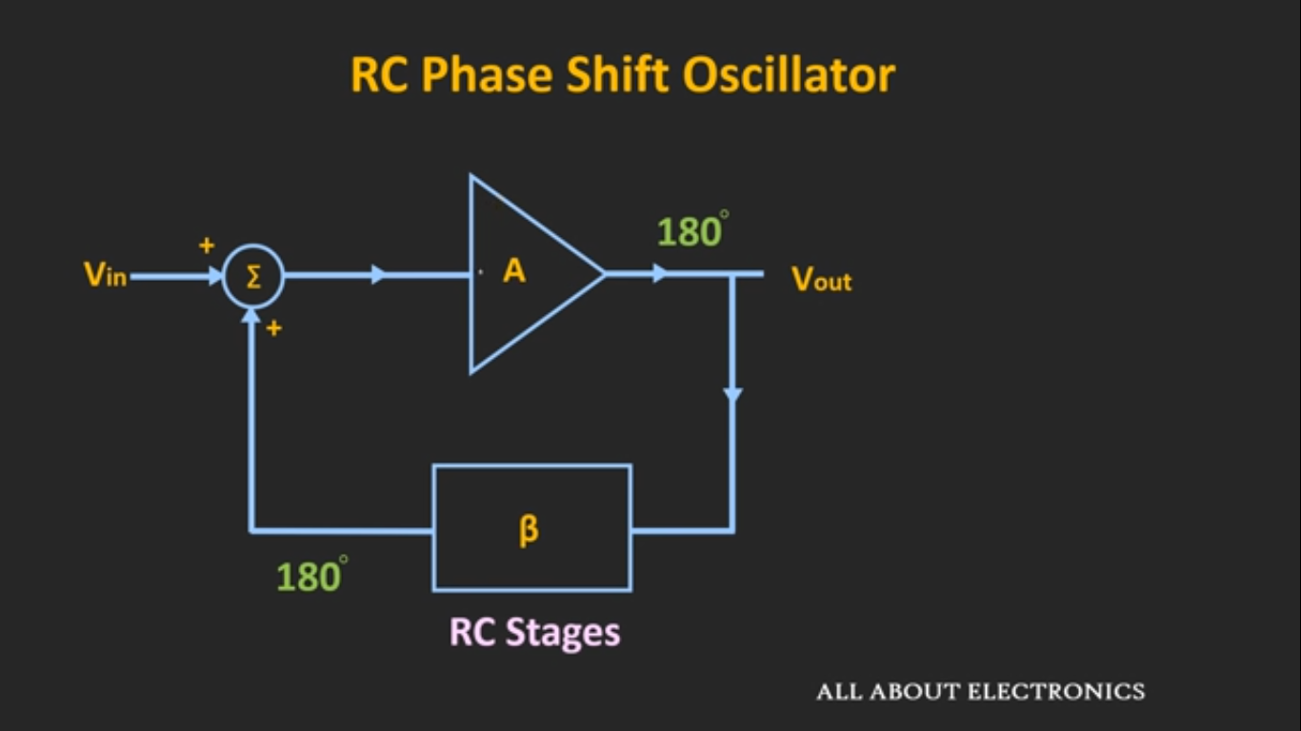
Working Principle

Slide 13
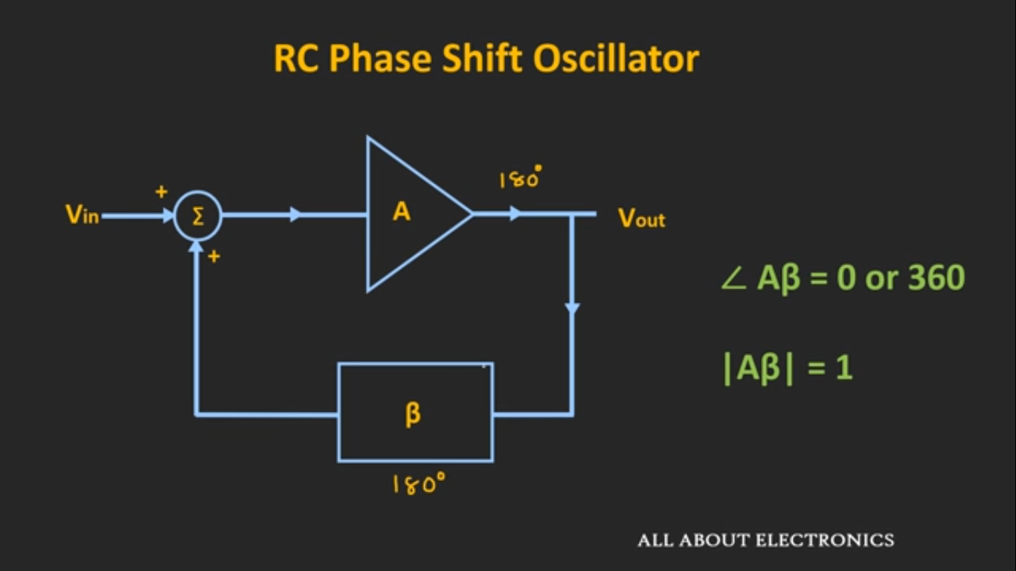
Working Principle

Slide 14
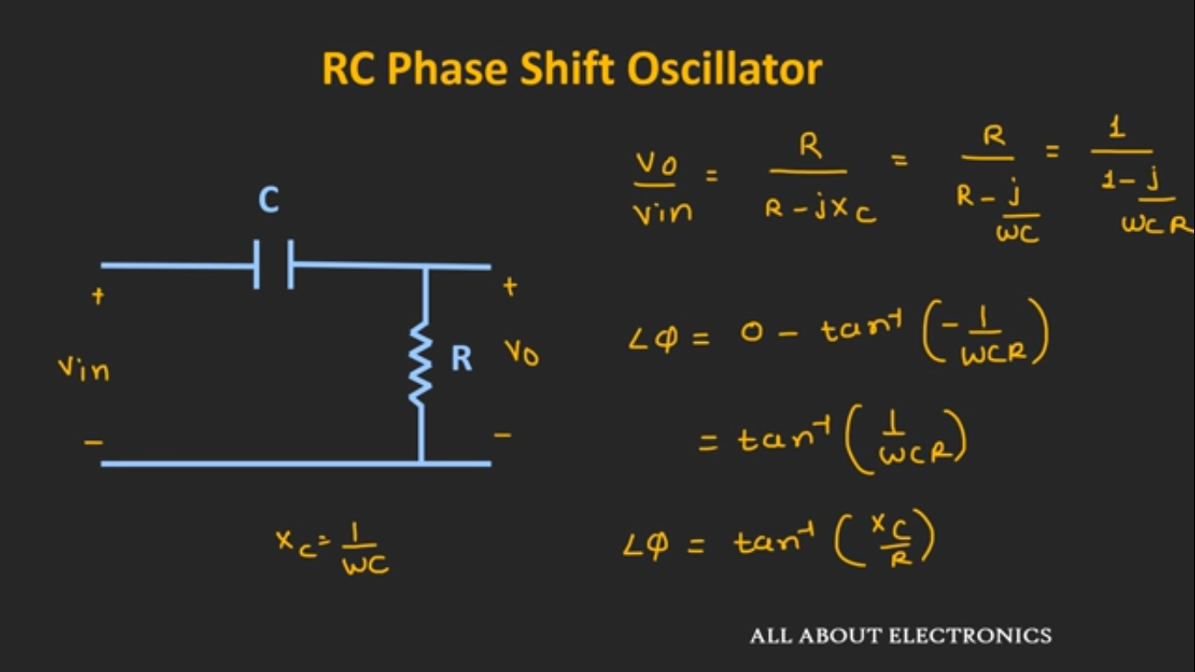
Working Principle

Slide 15
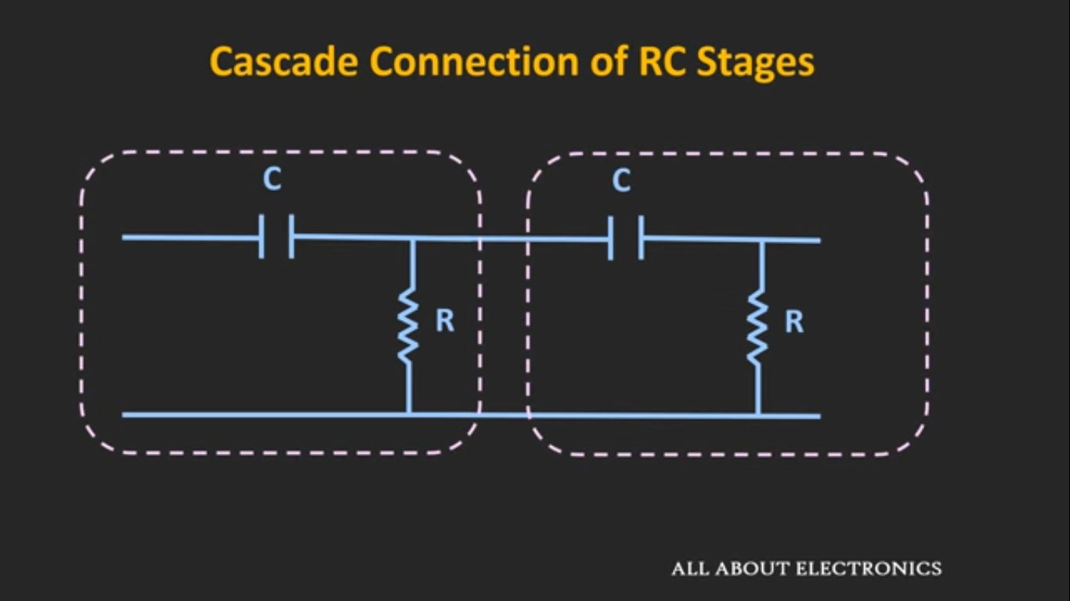
Working Principle

Slide 16
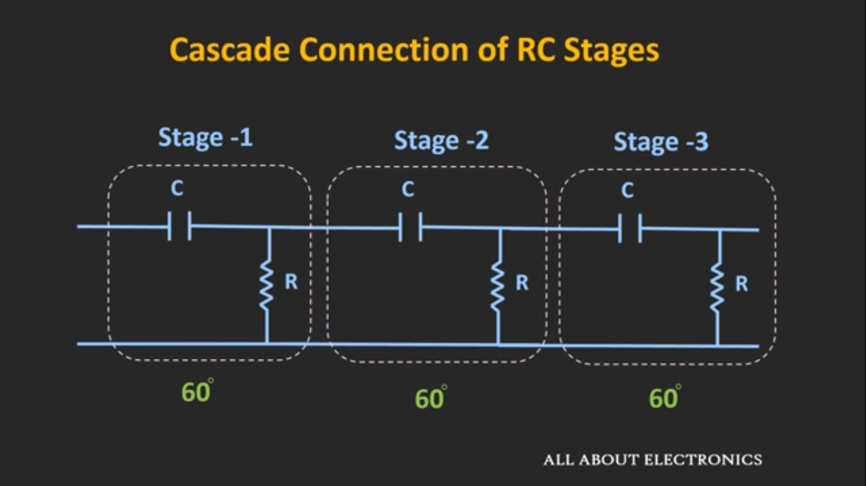
Working Principle

Slide 17
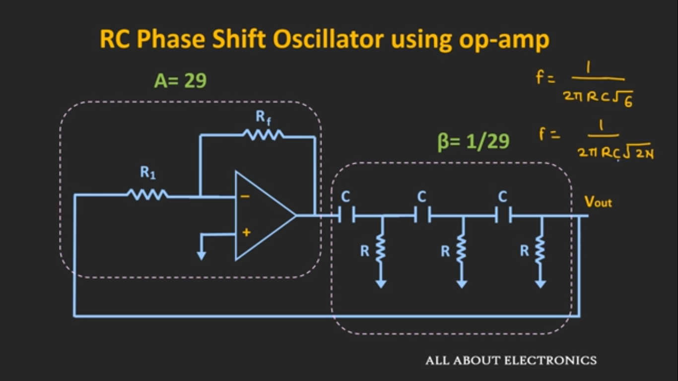
Working Principle

Slide 18
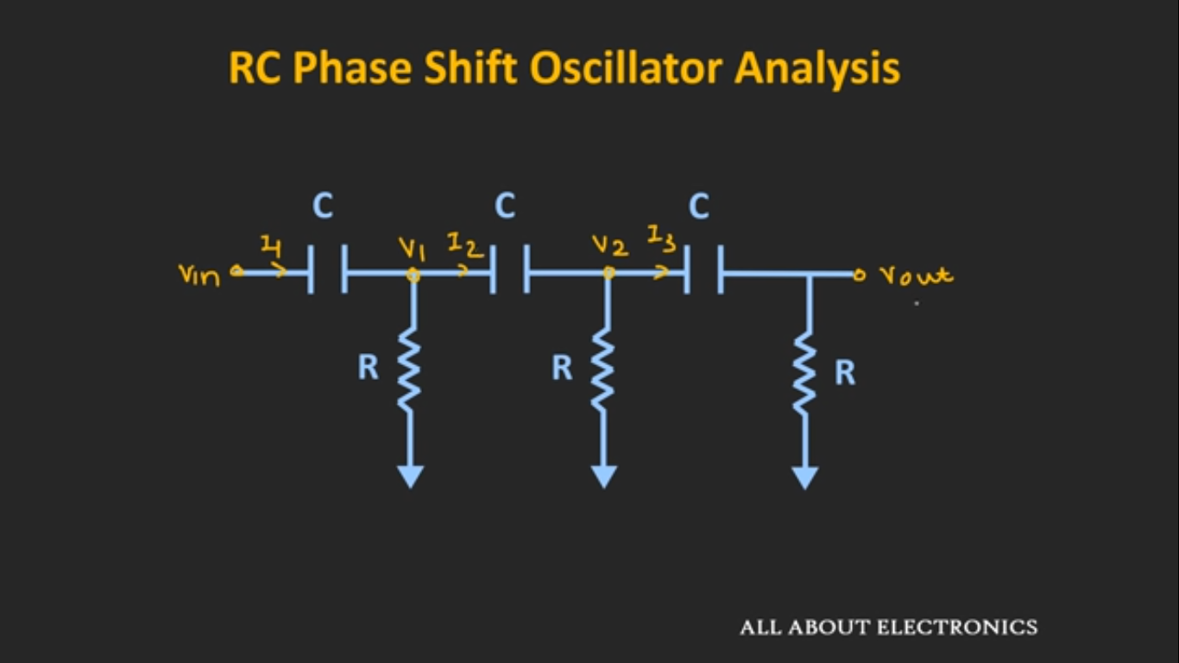
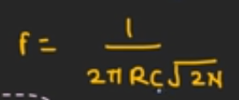
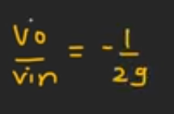
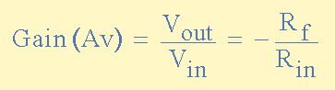
Working Principle

Slide 19
Advantage & Disadvantage
Advantage
Disadvantage
• This circuit is very simple and cheap as it comprises resistors and capacitors (not bulky and expensive high-value inductors).
They have a wide range of frequency (from a few Hz to several hundred of kHz).
It provides good frequency stability.
It needs high voltage (12 V) battery so as to develop a sufficiently large feedback voltage.
The frequency stability is not as good as that of the Wien bridge oscillator.

Slide 20

Application
1
2
RC Phase Shift Oscillators are used in musical instruments, voice synthesis and in GPS units since they work at all audio frequencies.
Similarly, the frequency ranges of 200 Hz to 2 kHz, 2 kHz to 20 kHz and 20 kHz to 200 kHz can be obtained by using other sets of resistors and they are used in low frequency operation.

Slide 21
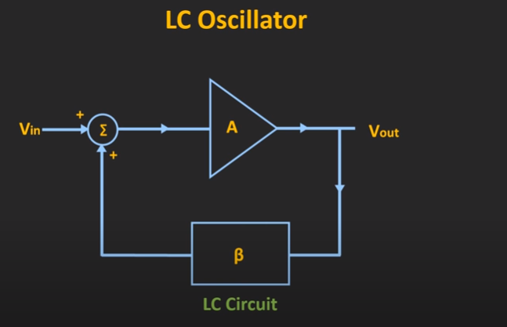
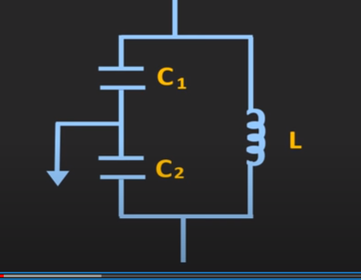
Colpitts Oscillator
One type of LC oscillator
Used in High frequency signal in the range of RF
LC circuit is used in the feedback path
of the Oscillator
The LC circuit resonates at the
resonant Frequency

Slide 22
Colpitts Oscillator
The Tank circuit uses as a frequency selector for the oscillator
An Lc circuit is called a tank circuit because
An energy swings between L and C thus
Making an oscillation. Lenz’s law
An amplifier must be used because the
oscillation will damp out
The LC circuit resonates at the
resonant Frequency

Slide 23
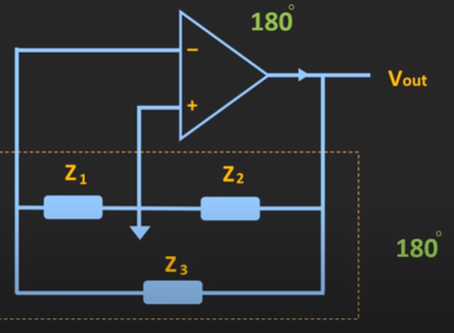
Colpitts Oscillator
The LC oscillator can have three components
If Z1 and Z2 are capacitors and Z3
are inductor . It is colpitts oscillator
If Z1 and Z2 are inductors and Z3
are capacitor . It is a Harley oscillator
The LC circuit resonates at the
resonant Frequency

Slide 24
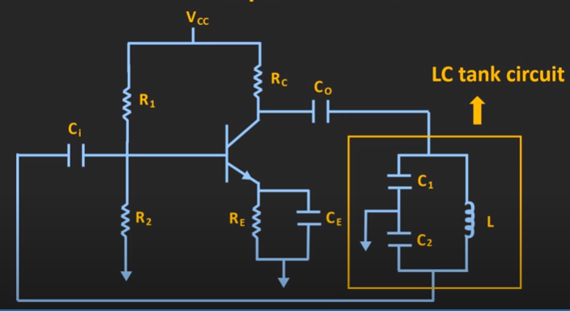
Colpitts Oscillator
This the basic Block Diagram of a colpitts oscillator
The feedback circuit will have a 180 phase shift
and the amplifier have another 180 phase shift.
so that the total phase shift is 0
The Barkhuasen criteria must be conserved
The Amplifier circuit can be made by a transistor
or an op amp.

Slide 25
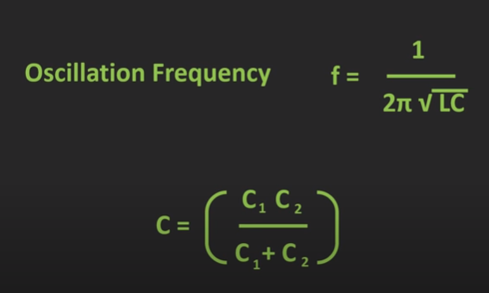
Colpitts Oscillator
By adjusting the loop gain of the feedback circuit
we can get the
The frequency of oscillation is 1 / 2 *pi (LC) ½
C= C1 C2 / C1+ C2
The Barkhuasen criteria is conserved

Slide 26
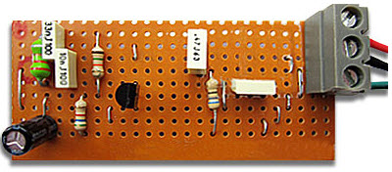
Colpitts Oscillator Applications
Colpitts oscillators are used for high frequency range and high frequency stability
A surface acoustical wave (SAW) resonator
Microwave applications
Mobile and communication systems

Slide 27
Colpitts Oscillator Applications
Typically, the operating frequency of the Colpitts oscillators ranges from 20 kHz to 300 MHz.
However, they can even be used for microwave applications as their capacitors provide a low reactance path for high-frequency signals

Slide 28
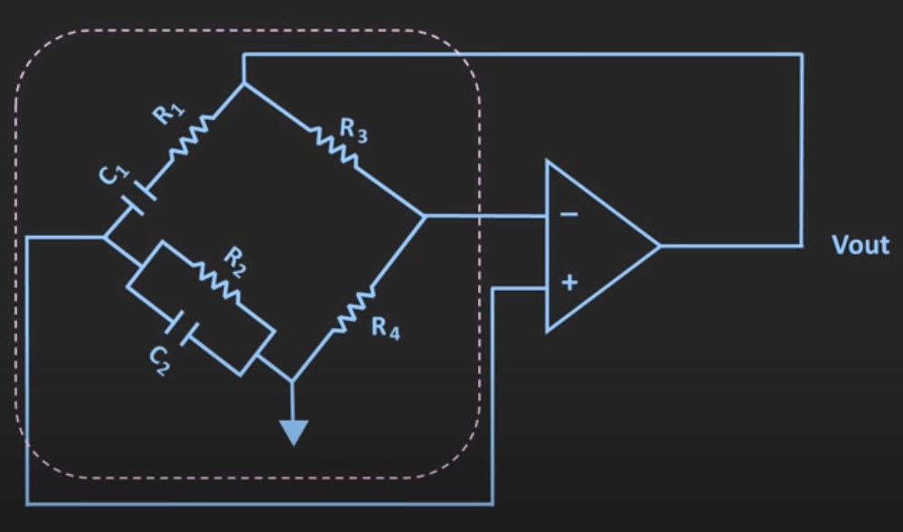
Wein Bridge Oscillator

Slide 29
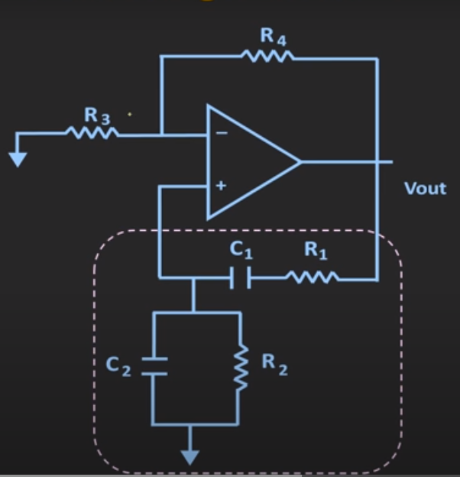
Working Principle

Slide 30
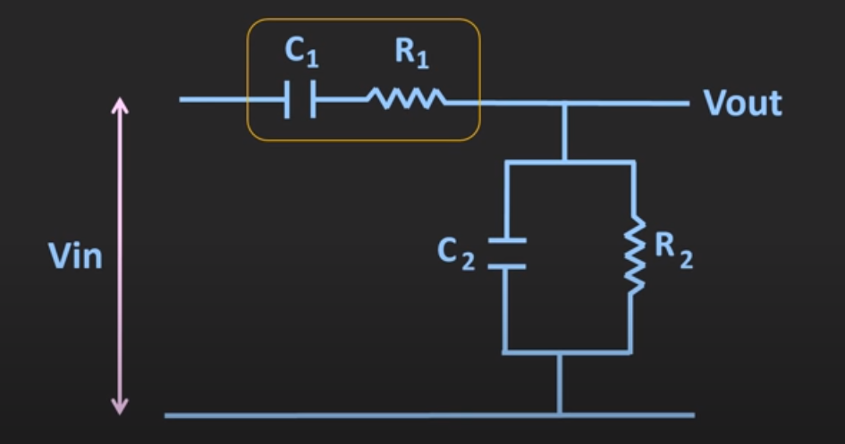
Working principle

Slide 31
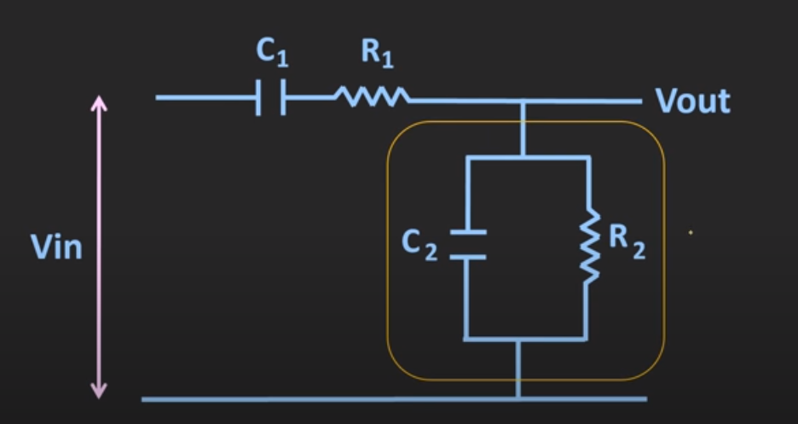
Working principle

Slide 32
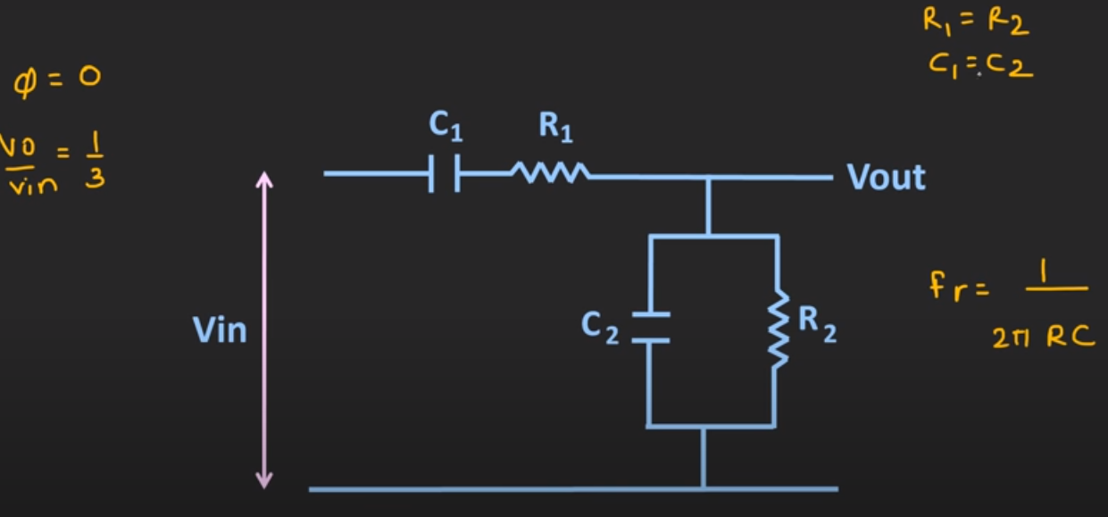
Working principle

Slide 33
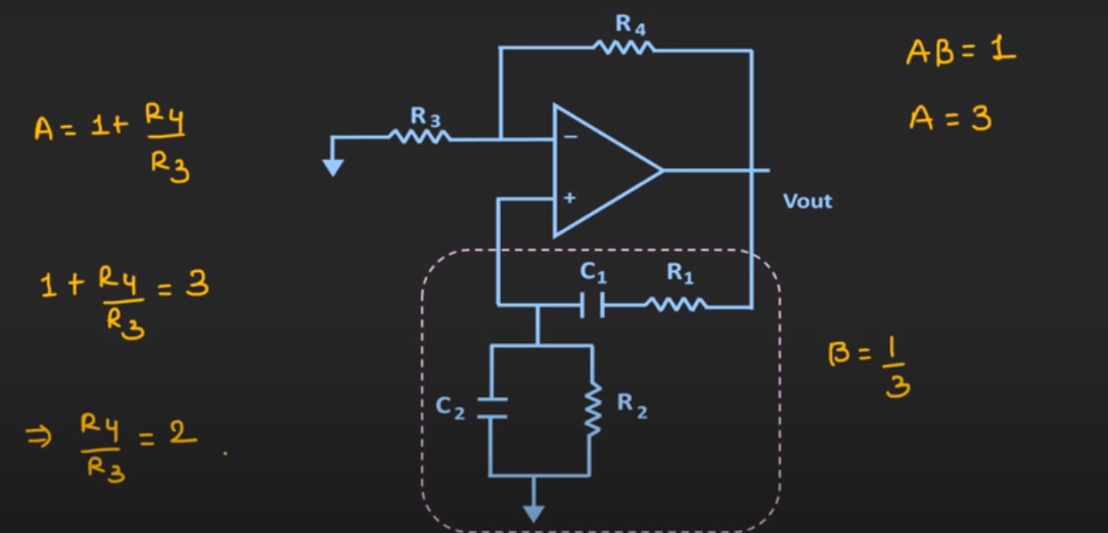
Working principle

Slide 34
Pros and Cons
Advantages | Disadvantages
By varying the two capacitors simultaneously, different frequency ranges can be obtained | Difficult to implement without op amp.
The perfect sine wave output is possible
Useful audio frequency range(20Hz-100KHz)
Example Text : Get a modern PowerPoint Presentation that is beautifully designed. I hope and I believe that this Template will your Time, Money and Reputation. Get a modern PowerPoint Presentation that is beautifully designed. I hope and I believe that this Template will your Time, Money and Reputation. You can simply impress your audience and add a unique zing and appeal to your Presentations.

Slide 35
Applications
1. Highly used for audio testing
2. Clock signals for testing filter circuits
3. Used in distortion testing of power amplifiers

Slide 36
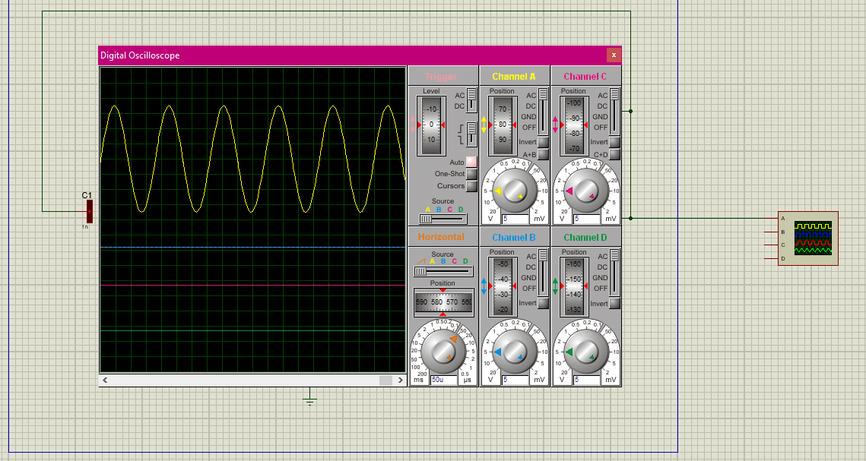
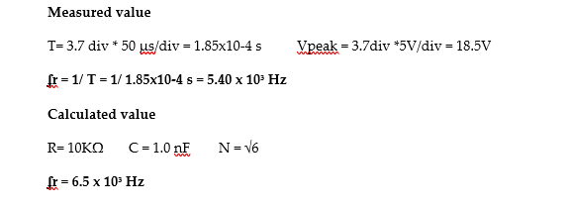
Simulation and Result
RC Phase Shift

Slide 37
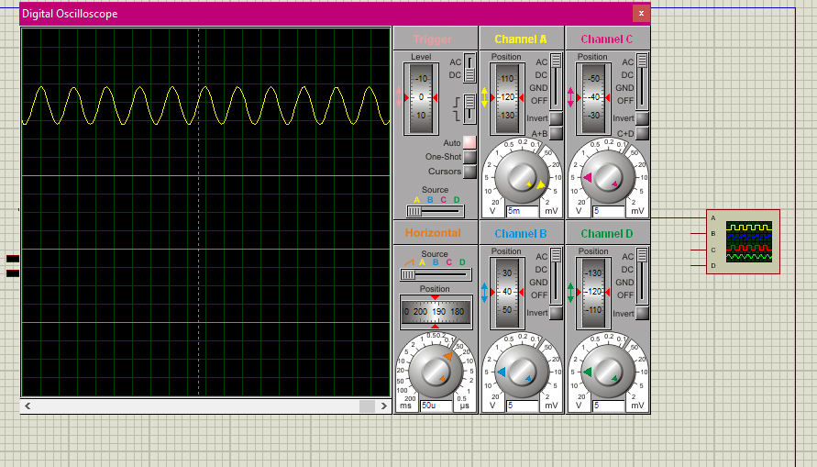
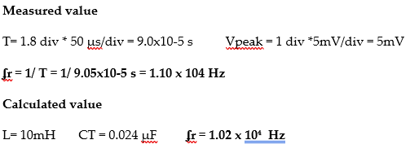
Simulation and Result
Colpitts Oscillator

Slide 38
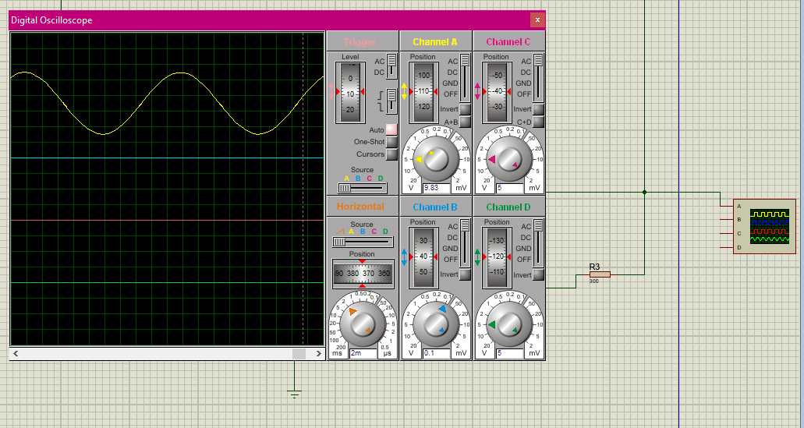
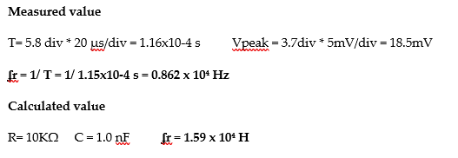
Simulation and Result
Wein Bridge Oscillator

Slide 39
Conclusion
RC phase shift oscillators are not comparatively suited for being a carrier signal in communication systems.
The Wien oscillator due to high frequency and large amplitude can modulate a base band signal to travel long distance and with stand degradation with only small decay.

Slide 40
THANK YOU

